Slide 1
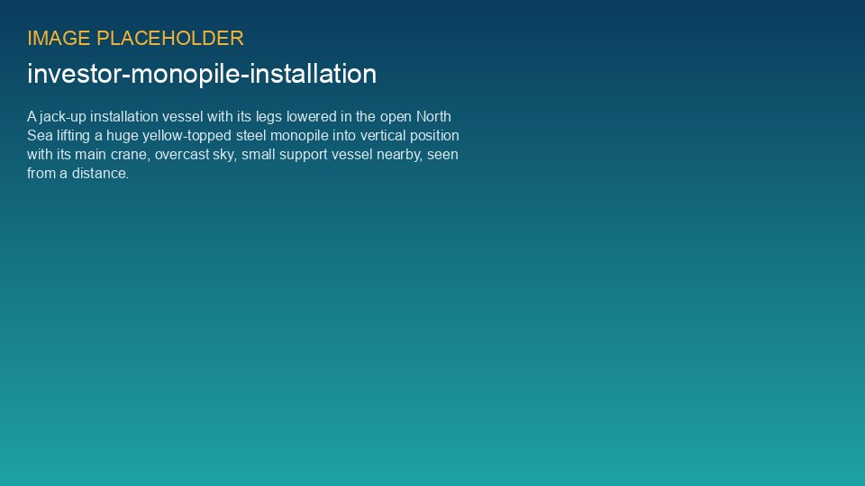
WEYLAND ENERGY
Harrow Bay site visit
Lender group · Port of Eastholm · 24 June 2026

Slide 2
Agenda
• Welcome and safety briefing (Hannah Weber)
• Construction status (Elena Márquez)
• Walk through the marshalling yard
• Lunch with the project team
• Boat trip to MV Sea Atlas (weather permitting)
WEYLAND ENERGY · Harrow Bay – Lender Site Visit
2

Slide 3
Progress at a glance
6 / 40
EUR 688 m
0
Jun 2028
monopiles installed
cost incurred
lost-time injuries
COD on track
WEYLAND ENERGY · Harrow Bay – Lender Site Visit
3

Slide 4
Offshore installation
• MV Sea Atlas: 2.6 days per monopile on average
• Double bubble curtain for noise mitigation
• Weather downtime 18 % (P75 allowance: 24 %)
WEYLAND ENERGY · Harrow Bay – Lender Site Visit
4

Slide 5
HSE
• HSE-INC-2026-018 near miss on 3 June – dropped shackle, no injuries
• Tool tethering and revised exclusion zone introduced
• Lessons shared with all contractors
WEYLAND ENERGY · Harrow Bay – Lender Site Visit
5
Notes:
Be open about the near miss – lenders' E&S adviser has the report already.

Slide 6
Next milestones
Milestone | Date
Offshore substation topside | August 2026
Export cable lay | Q4 2026 – Q1 2027
First turbine | March 2027
First power | September 2027
COD | 30 June 2028
WEYLAND ENERGY · Harrow Bay – Lender Site Visit
6

Slide 7
WEYLAND ENERGY
Thank you
Clean power, built to last.

